Slide 1
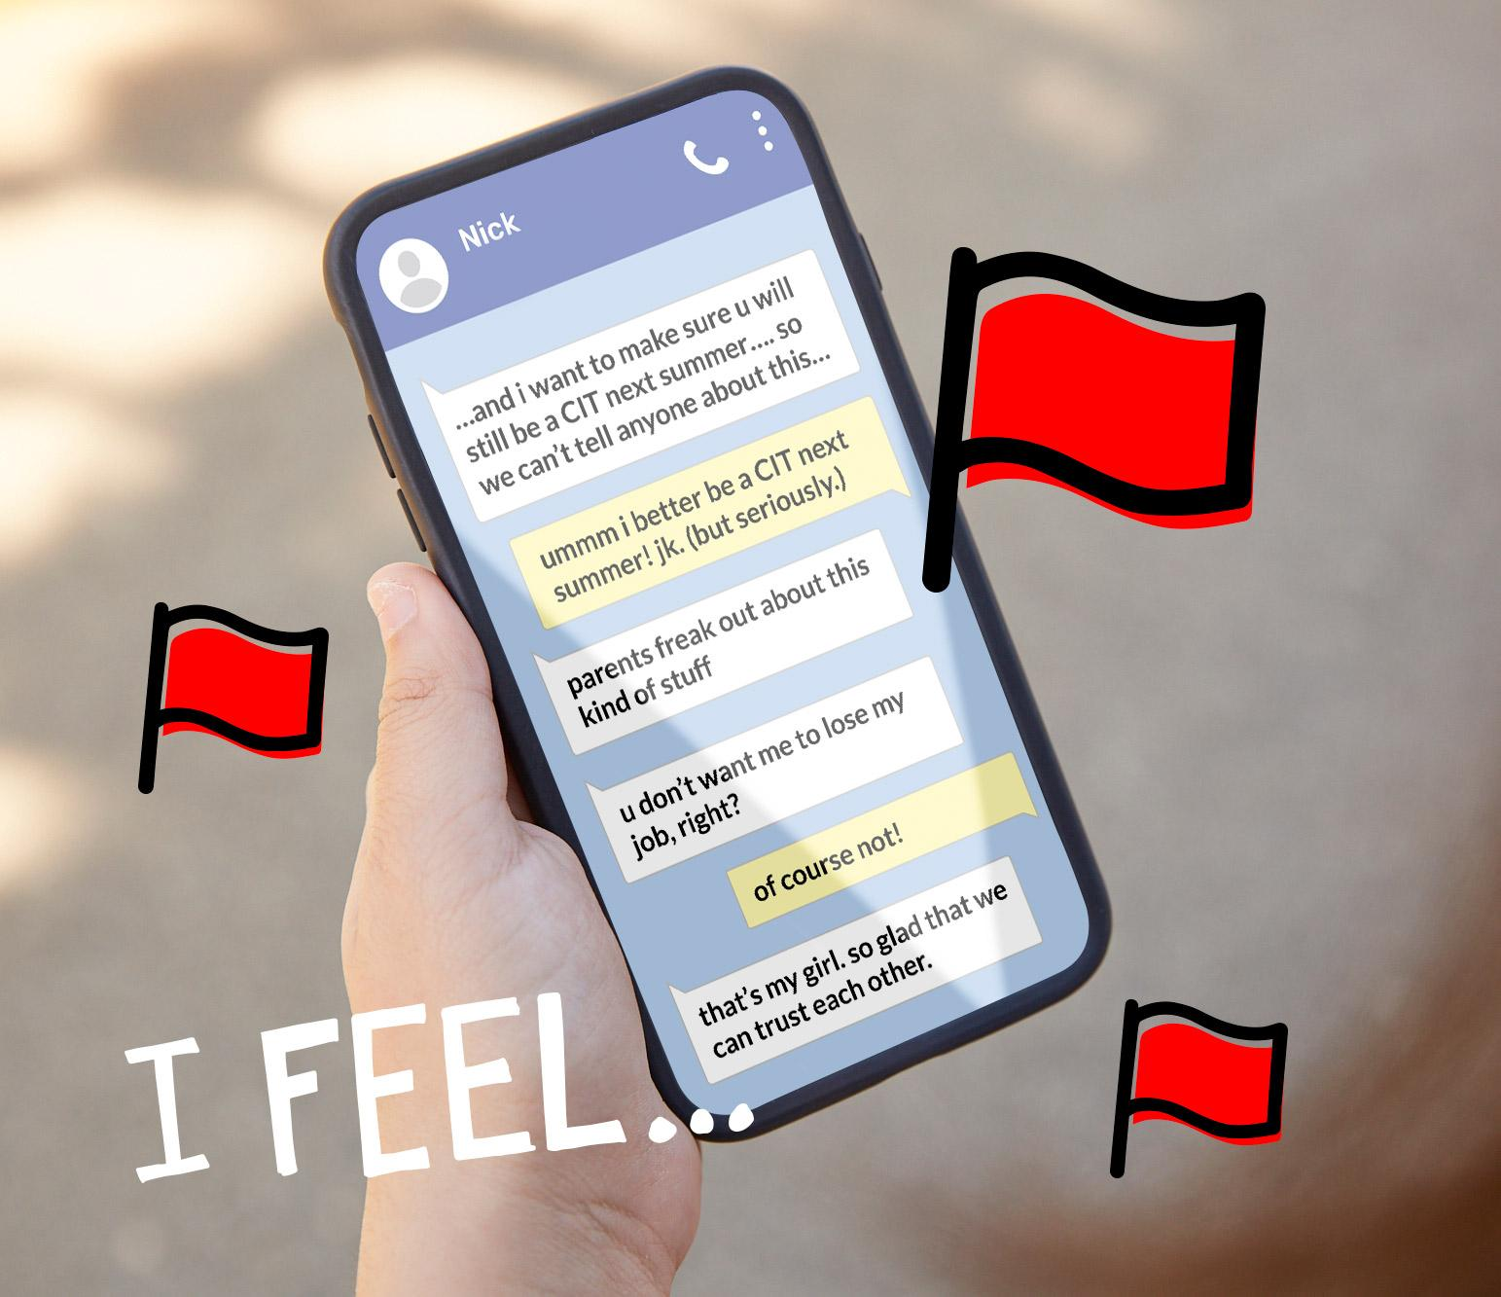
Chatting and Red Flags
DIGITAL CITIZENSHIP
Adapted version for youth with intellectual and developmental disabilities

Slide 2
PRE-TEACH
Risk is the possibility of something bad happening.
Risky behavior is an action or activity that can cause something bad to happen.

Slide 3
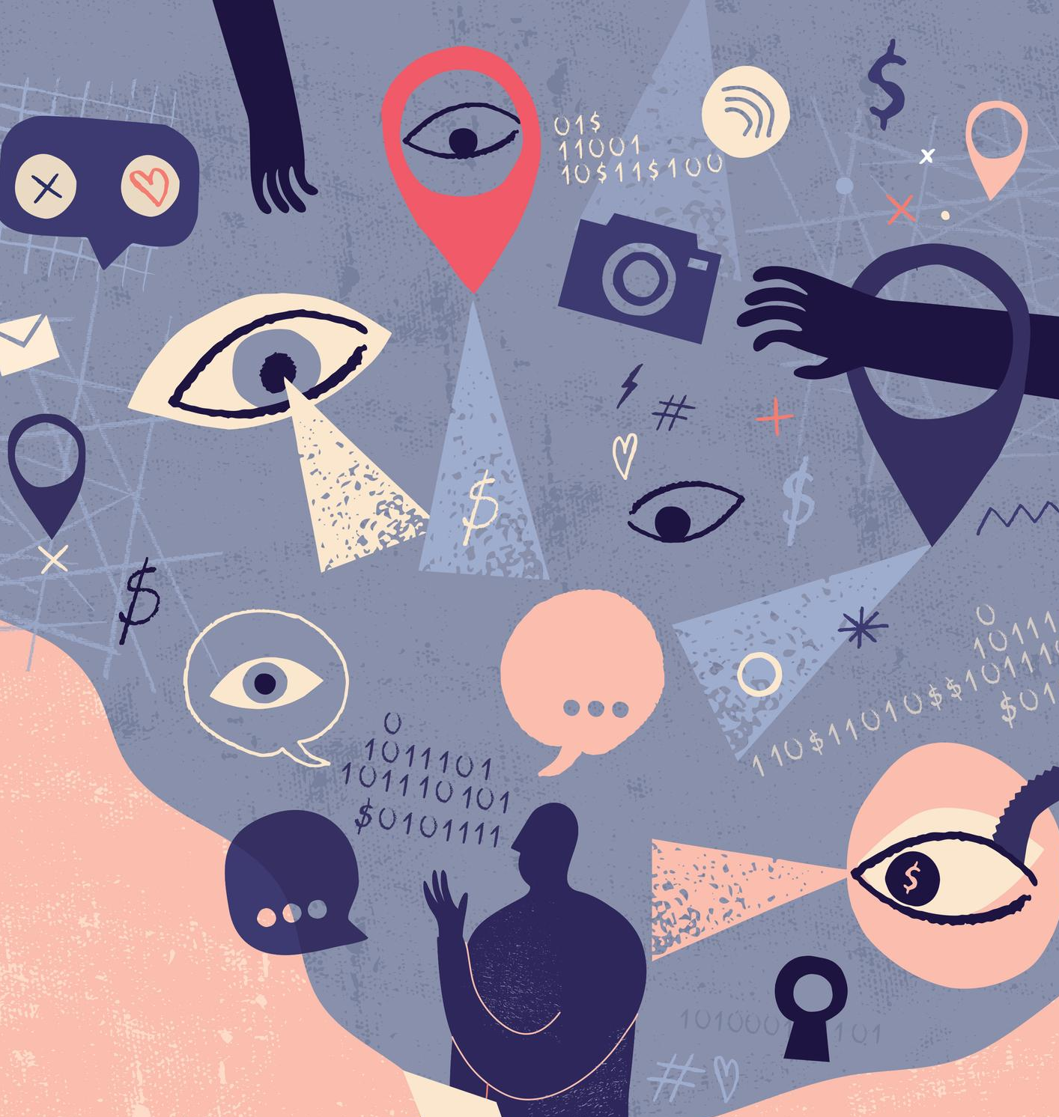
PRE-TEACH
What risky behavior could a teen try? Why?
Who do you know that doesn’t do risky things?

Slide 4
Learning Objectives
l
Learn what a red flag feeling is.
Identify the types of messages that might cause a red flag feeling for someone.
Use the Feelings & Options thinking routine to analyze and respond to a situation involving a red flag feeling.
2
3

Slide 5
WARM UP: RISKY ONLINE RELATIONSHIPS
Think about what you share online: text messages, social media, messaging apps, etc.
Do you share everything about yourself online?
Do you always share everything that happened to you online?
Do you ever act different online than you do in school or with your friends and family?

Slide 6
WATCH + DISCUSS
Discuss:
How are the texts in this video misleading?

Slide 7
READ: ONLINE CHAT - Sara and Asseal
Asseal’s teacher connected him with Sara, a teen from the next town over.
They both like playing video games.
They have been talking off and on for about a month through a messaging app.
They talk about gaming and problems they are having at school with friends.

Slide 8
READ: ONLINE CHAT - Sara and Asseal
Asseal, did you see the meme’s I sent you?
Sara
I did! They were funny, but they had a lot of swears in them.
Asseal
Yeah, but they were funny. Make sure your parents don’t see them.
Sara

Slide 9
READ: ONLINE CHAT - Jayden and alex_13
alex_13
You are so talented! Are you a professional photographer?
Jayden
Thanks! I’m not professional, I just like taking pictures.
alex_13
Can you post more selfies? I think u r beautiful.
alex_13
My cell is 555-687-1944 so u can send more personal pics directly to me.
alex_13
Just don’t tell anyone I gave u this.

Slide 10
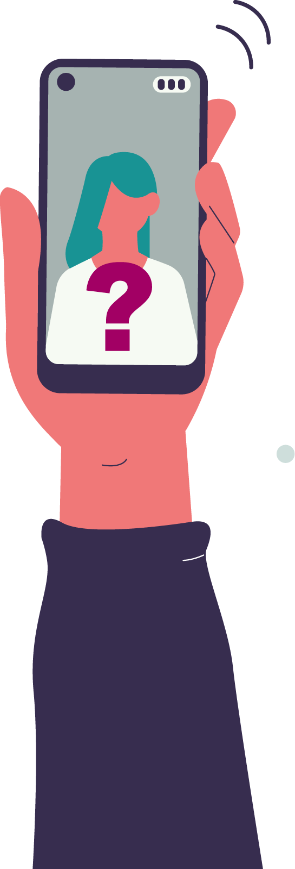
Questions to ask yourself when you are deciding if chatting with someone is risky:
Have I met this person in real life?
Do I know anyone who has met this person in real life?
Do I ever feel uncomfortable, worried or sad talking to this person?
What are they asking me to do or share?

Slide 11
KEY VOCABULARY
Red flag feeling
When something happens that makes you feel uncomfortable, worried, or upset.

Slide 12
KEY VOCABULARY
Grooming (online)
When someone uses online chatting or messaging to become friends with you so they convince you to do things you don’t want to do or shouldn’t do, like sharing inappropriate videos or pictures online.

Slide 13
ANALYZE: DIGITAL DILEMMA
Feelings & Options
Identify. Who are the people involved in the situation? What challenge are they facing?
Feel. What is each person in the situation feeling? Why is the situation making them feel this way?
Imagine. Imagine options for how the situation could be handled. What could the people do?
Say. What could the people involved say?

Slide 14
One day Sheyna and Nick have the following exchange:
Nick (Age 21):
Did you know I thought about you at camp all the time? I like couldn’t take my eyes off you.
Sheyna (Age 14):
😊 Why didn’t you say anything?
Nick
lol u were a camper
…and I want to make sure u will be a teen counselor next summer… so we can’t tell anyone about this…

Slide 15
One day Sheyna and Nick have the following exchange:
Sheyna (Age 14):
😊 ummmm I better be a teen counselor next summer! Jk. (but seriously)
Nick (Age 21):
parents freak out about this kind of stuff
u don’t want me to lose my job, right?
Sheyna
of course not!
Nick
that’s my girl. So glad that we can trust each other. Send me a picture of you in a bathing suit from camp 😊

Slide 16
One day Sheyna and Nick have the following exchange:
Nick (Age 21):
Did you know I thought about you at camp all the time? I like couldn’t take my eyes off you.
Sheyna (Age 14):
😊 Why didn’t you say anything?
Nick
lol u were a camper
…and I want to make sure u will be a teen counselor next summer… so we can’t tell anyone about this…

Slide 17
One day Sheyna and Nick have the following exchange:
Sheyna (Age 14):
😊 ummmm I better be a teen counselor next summer! Jk. (but seriously)
Nick (Age 21):
parents freak out about this kind of stuff
u don’t want me to lose my job, right?
Sheyna
of course not!
Nick
I know you live nearby. want to hang out tomorrow? My friend is having a party in the woods. just don’t tell your parents u r meeting me

Slide 18
Lesson Review

Slide 19
Decide whether the following online interactions are risky or safe.
Sharing your favorite music on social media..
Giving your address to a friend you know only online
Commenting on the post of a celebrity you admire..
Accepting a follow request from someone you don’t know

Slide 20
Which of the following statements about online relationships is true?
You can always trust that someone will represent their real self online.
Even your best friend can cause you to have red flag feelings.
Only people you don't know in real life can cause you to have red flag feelings.
It is always obvious when someone online has negative intentions.

Slide 21
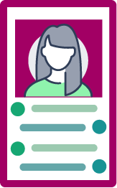
Red flag feelings
Ana started a photo account to share funny photos and quickly got a lot of followers. One day a follower she had been messaging with, but doesn't know in real life, sent her this message: "You are so funny! And your profile pic is so pretty! Want to meet up on video chat?" Ana is not sure what to do.
Why might she be having a red flag feeling?
The person should already know a lot about her based on the photos she posts.
A video chat is a personal and risky request from someone she doesn't know.
The person does not have as many followers as she does.
Ana has liked some of the photos the person has posted.

Slide 22
ANALYZE: DIGITAL DILEMMA
Feelings & Options
Identify. Who are the people involved in the situation? What challenge are they facing?
Feel. What is each person in the situation feeling? Why is the situation making them feel this way?
Imagine. Imagine options for how the situation could be handled. What could the people do?
Say. What could the people involved say?

Slide 23
What should Ana say or do using the Feelings & Options steps?
Take a chance and video chat with her follower.
Say that she prefers to meet in person because it's less awkward.
Say: “No, thank you. I don’t video chat with people I meet online.”

Slide 24
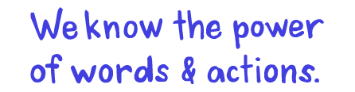
We know the power of words & actions.

