Slide 1
WELCOME
TABLE TENTS
Middle school (6 – 8th grade)
High school (9 – 12th grade)
Middle & High Schools
Multiple settings: middle, high schools and CBOs
Multiple settings: schools, CBOs, and non-traditional settings
Multiple settings: middle, high, and non-traditional settings
College campuses
Non-traditional settings
Community based organizations
Sit at a table with a table tent that describes the implementation setting of your SRAE program.
For example, if you implement in middle schools, sit at the table with the "middle school" table tent.

Slide 2
Trauma Informed Facilitation of SRAE Programming
Welcome & Opening Remarks

Slide 3
SRAE Opening Remarks

Slide 4
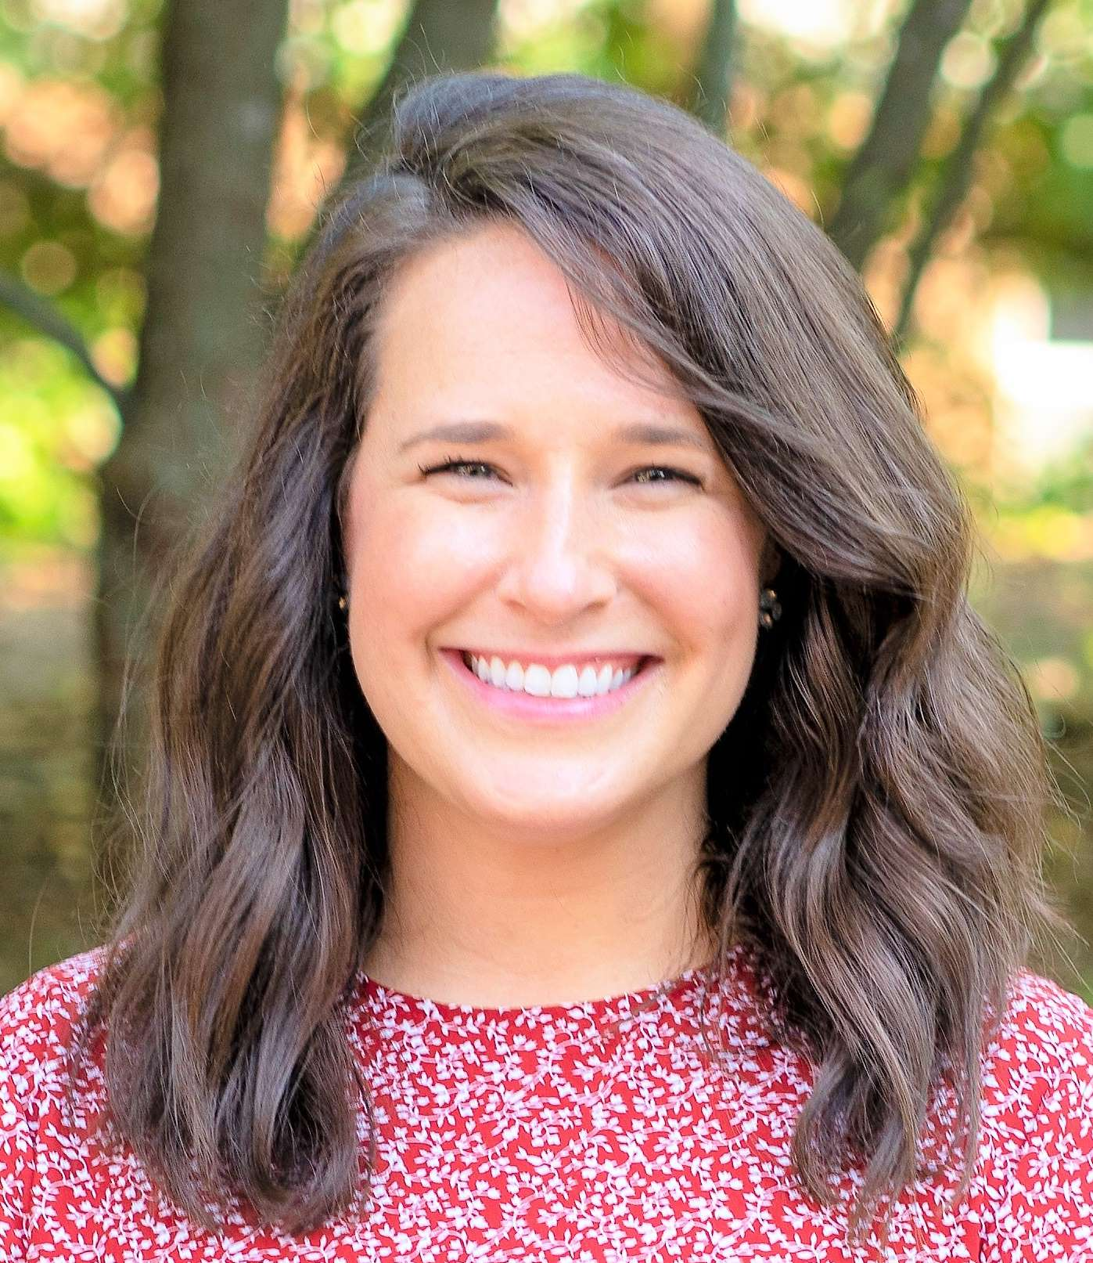
Speaker Introductions
Hannah Feeney, Ph.D.
Community Psychologist
RTI International
Caroline Huffaker, M.S., M.Ed.
Senior Victim Services Specialist
RTI International

Slide 5
Before we begin…
Ensure you have a nametag, workbook, and something to write with.
Access to:
Wi-Fi
Restrooms
Other private spaces
Our first break is scheduled for 10:50 AM.
Attendees are responsible for their own food and beverages.

Slide 6
Morning Agenda
9:00-9:10 Welcome & Opening Remarks
9:10-10:00 Networking
10:00-10:50 Session 1: Foundations of Trauma
10:50-11:00 BREAK
11:00-12:00 Session 2: Neurobiology of Trauma
12:00-1:30 LUNCH

Slide 7
Learning Objectives
Recognize how trauma presents in youth ages 10-19.
Define trauma informed facilitation and trauma theories.
Describe trauma informed principles and how they can be applied to facilitation.
Design a trauma informed session or adapt a current session to incorporate trauma informed approaches.

Slide 8
Networking
Implementation success within the last 6 months
What are you looking forward to learning during this training?
What questions do you have about this training or SRAE implementation?

