Slide 1
Foundations of Trauma
November 19, 2024

Slide 2
Learning Objectives
Recognize how trauma presents in youth ages 10-19.
Define trauma informed facilitation and trauma theories.
Describe trauma informed principles and how they can be applied to facilitation.
Design a trauma informed session or adapt a current session to incorporate trauma informed approaches.

Slide 3
Agenda
Establish meeting ground rules
What is trauma?
Key terms and definitions
What types of events result in trauma?
How often is this happening?
Risk and Protective Factors
Adverse Childhood Experiences (ACEs)
Examples

Slide 4
Content Warning
These sessions may include challenging content, and we encourage you to take care of yourself.
These sessions will include:
Descriptions of trauma and its impacts
Examples of types of events that may cause trauma or a trauma response
These sessions will not include:
Imagery depicting trauma
Detailed examples that include identifying information
Requests for attendees to share personal experiences of trauma

Slide 5
Ground Rules
We are committed to facilitating a respectful and meaningful learning environment.
What does this look like for us?

Slide 6
What is trauma?
Key terms and definitions

Slide 7
Definitions of Trauma
Diagnostic Statistical Manual of Mental Disorders 5th Edition
(DSM-V)
Substance Abuse and Mental Health Services Administration (SAMHSA)

Slide 8
Definitions of Trauma: D S M - V
Diagnostic Statistical Manual of Mental Disorders 5th Edition
(DSM-V)
For an event to be considered traumatic, it must involve one or more of the following to an individual, family member, or close friend:
Actual or threatened death
Serious injury
Sexual violence
This definition is limited compared to other definitions of trauma.
https://www.ncbi.nlm.nih.gov/books/NBK207191/box/part1_ch3.box16/

Slide 9
Definitions of Trauma: S A M H S A
Trauma results from an event, series of events, or set of circumstances that is experienced by an individual as:
Physically or emotionally harmful
or
Life threatening
and
Has lasting adverse effects on the individual’s functioning and mental, physical, social, emotional, or spiritual well-being.
This definition is more comprehensive.
Substance Abuse and Mental Health Services Administration (SAMHSA)
https://store.samhsa.gov/sites/default/files/sma14-4884.pdf

Slide 10
Definitions of Trauma: Event & Stress
Traumatic event: The circumstance that causes trauma.
Traumatic stress: When exposure to one or more traumatic events overwhelms an individual’s ability to cope.
About Child Trauma | The National Child Traumatic Stress Network (nctsn.org)

Slide 11
SAMHSA’s Three “E’s” of Trauma
Events
One time or reoccurring actual or extreme threat of physical or psychological harm or neglect.
Experience
Co-occurring factors, including risk and protective factors, that impact interpretation of the event.
Effects
Immediate or delayed onset adverse impacts of the event.
https://store.samhsa.gov/sites/default/files/sma14-4884.pdf

Slide 12
What types of events result in trauma?
Traumatic events and complex trauma

Slide 13
What types of events result in trauma?
Physical abuse or neglect
Sexual abuse
Psychological abuse or neglect
Substance Use Disorder
Serious accidents
Witnessing others’ trauma

Slide 14
What types of events result in trauma?
Disasters
Mass violence
Medical trauma
Bullying
Loss of a loved one
Traumatic separation

Slide 15
What types of events result in trauma?
Military-family related stressors
Refugee or war experiences
Discrimination, prejudice, & racism
Something else

Slide 16
What is complex trauma?
Complex trauma is a form of trauma that is marked by:
Exposure to multiple traumatic events, that are often severe and recurring (e.g., chronic sexual abuse, profound neglect)
Typically occurs with a caregiver
Typically occurs during childhood or adolescence
https://www.nctsn.org/what-is-child-trauma/trauma-types/complex-trauma

Slide 17
How often is this happening?
How common are traumatic events?

Slide 18
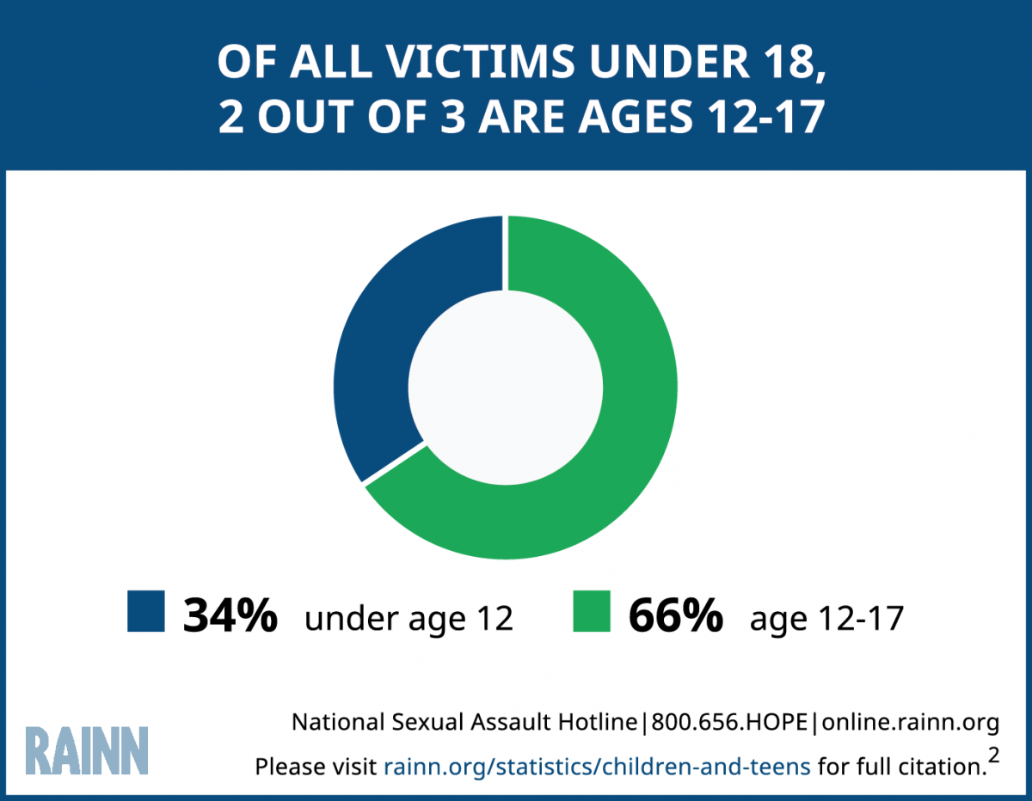
How often is this happening?
1:9 girls and 1:20 boys under the age of 18 have experienced sexual abuse or assault.
David Finkelhor, Anne Shattuck, Heather A. Turner, & Sherry L. Hamby, The Lifetime Prevalence of Child Sexual Abuse and Sexual Assault Assessed in Late Adolescence, 55 Journal of Adolescent Health 329, 329-333 (2014)

Slide 19
How often is this happening?
Every year, the number of youth who require medical treatment for physical assault related injuries, could fill every seat in 9 stadiums.
National Center for Injury Prevention and Control: Division of Violence Protection (2014). Taking Action to Prevent Youth Violence: A Companion Guide to Preventing Youth Violence: Opportunities for Action. http://www.cdc.gov/violenceprevention/youthviolence/pdf/opportunities-for-action-companion-guide.pdf

Slide 20
How often is this happening?
Nearly 20% of students enrolled in grades 6-12 experienced bullying during the 2021-2022 school year.
Thomsen, E., Henderson, M., Moore, A., Price, N., and McGarrah, M.W. (2024). Student Reports of Bullying: Results From the 2022 School Crime Supplement to the National Crime Victimization Survey (NCES 2024-109rev). U.S. Department of Education. Washington, DC: National Center for Education Statistics. Retrieved [date] from https://nces.ed.gov/pubsearch/pubsinfo.asp?pubid=2024109rev

Slide 21
Risk and Protective Factors
What impacts the experience of trauma?

Slide 22
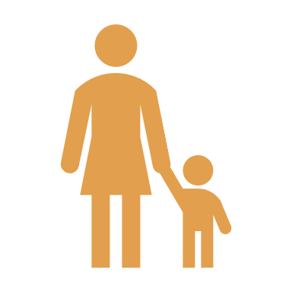
Risk and Protective Factors
Trauma impacts people of all ages, races, religions, socioeconomic status, sexual orientation, and more.
Not all people are impacted by traumatic events in the same way. The context in which the trauma occurs matters.
This is the second “E” in SAMHSA’s Three “E’s” of Trauma.
Five key factors can help predict the impact of the trauma.
https://www.nctsn.org/what-is-child-trauma/about-child-traumaTrauma | The National Child Traumatic Stress Network (nctsn.org)

Slide 23
Risk & Protective Factors
Severity of the event.
Proximity to the event.
Caregivers’ reactions.
Prior history of trauma.
Family and community factors.
https://www.nctsn.org/what-is-child-trauma/about-child-traumaTrauma | The National Child Traumatic Stress Network (nctsn.org)

Slide 24
A Discussion of ACEs
Is this shortcut helpful to understanding trauma amongst youth?

Slide 25
What are ACEs
ACEs are Adverse Childhood Experiences.
The term originated from a groundbreaking study conducted in 1995-1997 to better understand childhood abuse, neglect, and household stressors, and their long-term impacts.
Data from this study helps shed light on how pervasive ACEs are.
Over time, ACEs-based screening tools have become a common way to identify children and youth needed more support.
https://www.cdc.gov/violenceprevention/aces/about.html

Slide 26
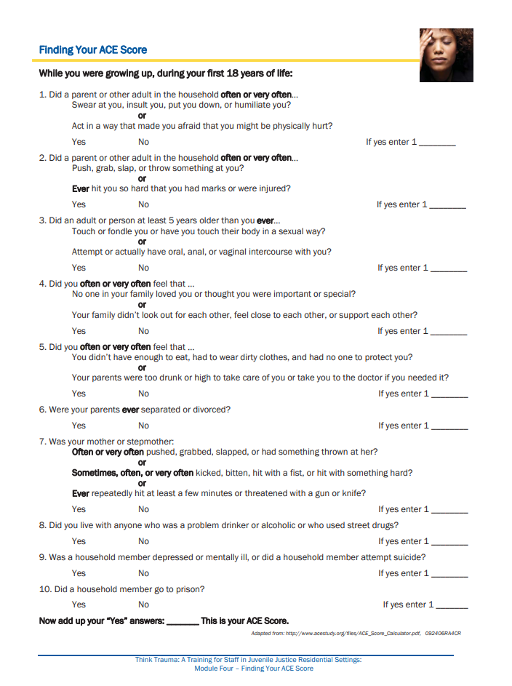
What are ACEs
Source: https://www.ncjfcj.org/publications/finding-your-ace-score/

Slide 27
Limitations of ACEs
This is a checklist – it does not account for SAMHSA’s Three “E’s” of Trauma.
Events: It does not account for the diverse ways trauma can be experienced by youth.
Experience: It does not account for risk or protective factors (though some attempt to).
Effects: It does not indicate whether youth are currently experiencing impacts or their severity.
This can be an excellent tool to get a conversation started.

Slide 28
Reflection
What is one thing from this session that stood out to you?
What is one question that you still have?
What is one thing you want to take back to your team?

Slide 29
BREAK
PLEASE RETURN TO YOUR SEATS IN 10 MINUTES

