Slide 1
Vicarious Trauma
November 19, 2024

Slide 2
Afternoon Agenda
1:30-3:30 Session 3: Vicarious Trauma
3:30-3:45 BREAK
3:45-4:30 Session 4: What Does it Mean to be Trauma Informed?
4:30-5:00 Day 1 Reflection and Networking

Slide 3
Learning Objectives
Recognize how trauma presents in youth ages 10-19.
Define trauma informed facilitation and trauma theories.
Describe trauma informed principles and how they can be applied to facilitation.
Design a trauma informed session or adapt a current session to incorporate trauma informed approaches.

Slide 4
Agenda
What is vicarious trauma?
Key terms and definitions
Sources of vicarious trauma
Impacts of vicarious trauma
Mitigation strategies for vicarious trauma
Risk factors and protective factors
Journaling and Discussion

Slide 5
What is Vicarious Trauma?
Key Terms and Definitions

Slide 6
What is vicarious trauma?
A form of trauma that occurs when one experiences traumatic stress reactions resulting from exposure to another’s traumatic experiences, rather than from direct exposure.
xx

Slide 7
Sources of vicarious trauma
Indirect exposure occurs upon hearing about, learning about, or witnessing another’s trauma or victimization. This can occur from things like…
For many occupations, vicarious trauma is considered an expected or inevitable occupational hazard. This includes victim services, law enforcement, emergency medical services, and fire services. It can also include educators.
Learning about abuse a student is experiencing at home
Losing a student
Learning about a student’s difficult circumstances, such as lack of resources
https://ovc.ojp.gov/program/vtt/what-is-vicarious-trauma#vtt-model

Slide 8
Impacts of Vicarious Trauma

Slide 9
Trauma Stewardship
Notes:
Internet access needed to watch video. https://youtu.be/tAKPgNZi_as

Slide 10
Impacts of vicarious trauma
Those affected by vicarious trauma may undergo the same physical, psychological, and cognitive changes experienced by those directly impacted by trauma.
These reactions can occur immediately or over time.

Slide 11
Impacts of vicarious trauma
However, other responses are possible. And not all are negative…

Slide 12
Vicarious Trauma Toolkit Model
Work-Related Trauma Exposure = Vicarious Trauma
Change in Worldview
Spectrum of Responses
Negative
Neutral
Positive
Adapted from https://ovc.ojp.gov/program/vtt/what-is-vicarious-trauma#vtt-model

Slide 13
Vicarious Trauma Toolkit Model
Spectrum of Responses
Negative
Neutral
Positive
Vicarious traumatization
Secondary Traumatic Stress
Compassion Fatigue, Burnout
Adapted from https://ovc.ojp.gov/program/vtt/what-is-vicarious-trauma#vtt-model

Slide 14
Impacts of vicarious trauma: Negative
VICARIOUS TRAUMATIZATION: a negative reaction to trauma exposure and includes a range of psychosocial symptoms.
SECONDARY TRAUMA STRESS (STS): the natural emotions that often result from knowing about a traumatizing event experienced by another and the stress resulting from helping, or wanting to help, a traumatized or suffering person. Its symptoms can mimic those of posttraumatic stress disorder.
https://ovc.ojp.gov/program/vtt/glossary-terms

Slide 15
Impacts of vicarious trauma: Negative
COMPASSION FATIGUE: a combination of physical, emotional, and spiritual depletion associated with caring for others who are in significant emotional pain and physical distress.
BURNOUT: a state of physical, emotional, and mental exhaustion caused by long-term involvement in emotionally demanding situations. Symptoms may include depression, cynicism, boredom, loss of compassion, and discouragement.
Note: These terms are often used interchangeably but have distinct and overlapping meanings.
https://ovc.ojp.gov/program/vtt/glossary-terms

Slide 16
Impacts of vicarious trauma: Negative
Difficulty managing emotions
Feeling emotionally numb or shut down
Fatigue or difficulty falling asleep
Being easily distracted
Relationship problems
Excessive worrying
Increased irritability, anger, or outbursts
Destructive coping mechanisms, like substance use
Self isolation or avoidance of things that you love
Hopelessness
https://ovc.ojp.gov/program/vtt/what-is-vicarious-trauma#vtt-model

Slide 17
Drowning in Empathy: The Cost of Vicarious Trauma. Amy Cunningham
Notes:
Internet access needed to watch video. https://youtu.be/ZsaorjIo1Yc

Slide 18
Vicarious Trauma Toolkit Model
Spectrum of Responses
Negative
Neutral
Positive
Vicarious traumatization
Secondary Traumatic Stress
Compassion Fatigue, Burnout
Impact managed effectively
Adapted from https://ovc.ojp.gov/program/vtt/what-is-vicarious-trauma#vtt-model

Slide 19
Vicarious Trauma Toolkit Model
Spectrum of Responses
Negative
Neutral
Positive
Vicarious traumatization
Secondary Traumatic Stress
Compassion Fatigue, Burnout
Impact managed effectively
Vicarious Resilience
Vicarious Transformation
Compassion Satisfaction
Adapted from https://ovc.ojp.gov/program/vtt/what-is-vicarious-trauma#vtt-model

Slide 20
Impacts of vicarious trauma: Positive
VICARIOUS RESILIENCE: a process of learning about overcoming adversity from a trauma survivor and the resulting positive transformation and empowerment experienced through witnessing the survivor's empathy and interaction.
VICARIOUS TRANSFORMATION: an ongoing, intentional process that results in a deepened sense of connection with others, a greater appreciation in one's life, and a greater sense of meaning and hope.
COMPASSION SATISFACTION: the pleasure derived from work, including feeling positively about the meaningfulness of one's contribution to the work and/or to the greater good of society.
https://ovc.ojp.gov/program/vtt/glossary-terms

Slide 21
Impacts of vicarious trauma
Vicarious trauma can impact the way educators engage with students.

Slide 22
Discussion
What do you need from your program to be able to do this work?
What feels challenging about tackling trauma informed concepts?

Slide 23
Mitigation Strategies
Risk Factors and Protective Factors

Slide 24
Risk Factors for Vicarious Trauma
PROFESSIONAL ENVIRONMENT RISK FACTORS
Lack of quality supervision
Lack of workplace support
Stressful or toxic workplace
Dangerous work environment
Inadequate training
https://ovc.ojp.gov/sites/g/files/xyckuh226/files/media/document/vt_intro_to_vt_for_victim_services-508.pdf

Slide 25
Risk Factors for Vicarious Trauma
PERSONAL RISK FACTORS
Previous trauma history
Pre-existing challenges, like anxiety
Limited support system in personal life
New to role or little experience responding to trauma
https://ovc.ojp.gov/sites/g/files/xyckuh226/files/media/document/vt_intro_to_vt_for_victim_services-508.pdf

Slide 26
Protective Factors for Vicarious Trauma
1. Trauma informed leadership
2. Trauma informed management and supervisors
3. Supportive work culture
4. Training and professional development on trauma informed approaches
5. Prioritization of staff health and wellness
PROFESSIONAL ENVIRONMENT PROTECTIVE FACTORS
https://ovc.ojp.gov/program/vtt/tools-for-victim-services#0-4

Slide 27
Protective Factors for Vicarious Trauma
PERSONAL PROTECTIVE FACTORS
Established support system in personal life
Taking dedicated time away from work, including to focus on healthy hobbies
Engaging coping mechanisms when at work
Seeking out training
Actively working on existing challenges, such as by going to therapy
Figley, C.R. (1995). Compassion fatigue: Coping with secondary traumatic stress disorder in those who treat the traumatized. New York: Brunner/Mazel, Inc.

Slide 28
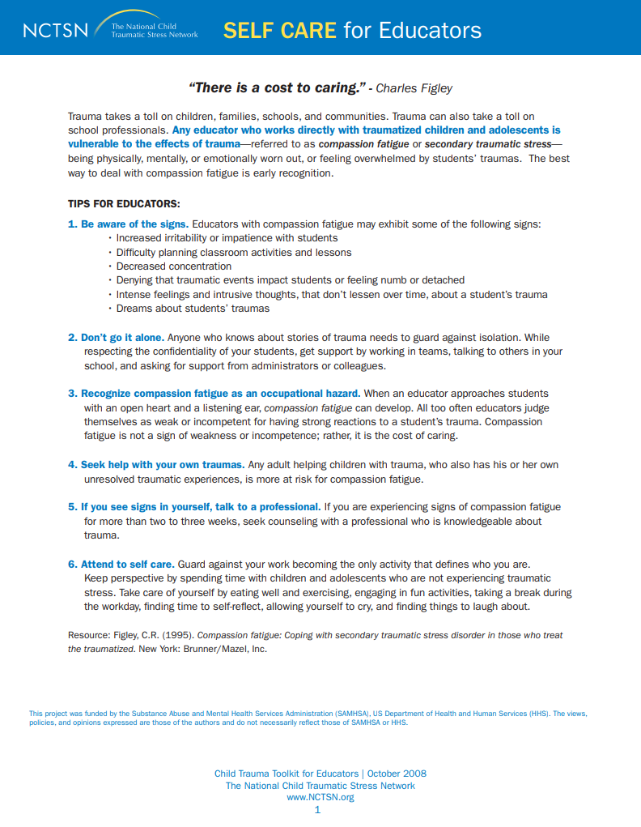
Resource: Self Care for Educators
Be aware of the signs
Don’t go it alone
Recognize compassion fatigue as an occupational hazard
Seek help with your own traumas
If you see signs in yourself, talk to a professional
Attend to self care
Figley, C.R. (1995). Compassion fatigue: Coping with secondary traumatic stress disorder in those who treat the traumatized. New York: Brunner/Mazel, Inc.

Slide 29
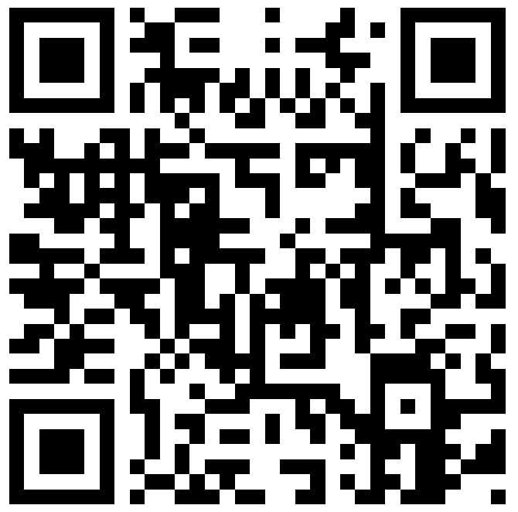
Vicarious Trauma Toolkit
The Office for Victims of Crime has created a comprehensive Vicarious Trauma Toolkit.
It is intended for victim services, EMS, fire services, and law enforcement, but can be leveraged by other groups.
Explore the OVC VTT by using the QR code or going to https://ovc.ojp.gov/program/vtt/introduction

Slide 30
Journaling
How would you notice vicarious trauma coming up for you?
What protective factors can you rely on?
What are strategies you’d like to implement to mitigate vicarious trauma?

Slide 31
Discussion
What does vicarious trauma look like in your setting? What have you witnessed amongst your peers?

Slide 32
Reflection
What is one thing from this session that stood out to you?
What is one question that you still have?
What is one thing you want to take back to your team?

Slide 33
BREAK
PLEASE RETURN TO YOUR SEATS AT 3:45

