Slide 1
Trauma Informed Leadership
November 20, 2024

Slide 2
Afternoon Agenda
1:30-2:15 Session 3: Trauma Informed Leadership
2:15-2:30 BREAK
2:30-4:30 Session 4: Strategies for a Trauma Informed Learning Environment: Part 2
4:30-5:00 Day 2 Reflection and Closing

Slide 3
Learning Objectives
Recognize how trauma presents in youth ages 10-19.
Define trauma informed facilitation and trauma theories.
Describe trauma informed principles and how they can be applied to facilitation.
Design a trauma informed session or adapt a current session to incorporate trauma informed approaches.

Slide 4
Agenda
Trauma Informed Leadership
The importance of the approach
Models for trauma informed leadership
Organizational Assessment of Trauma Informed Approaches
Strategies for Trauma Informed Leadership

Slide 5
Trauma Informed Leadership

Slide 6
Why Is Trauma Informed Leadership Important?
As summarized by the Office for Victims of Crime:
Leadership can sustain staff by anticipating and responding to staff needs, showing appreciation, and creating safe forums for communication (McFarlane and Bryant 2007; Howlett and Collins 2014).
Advocates who received more support from teams experienced lower levels of secondary traumatic stress (Slattery and Goodman 2009).
Greater access to the organization's strategic information lowers levels of vicarious trauma (Choi 2011).
https://ovc.ojp.gov/program/vtt/what-is-the-vt-org#five-org

Slide 7
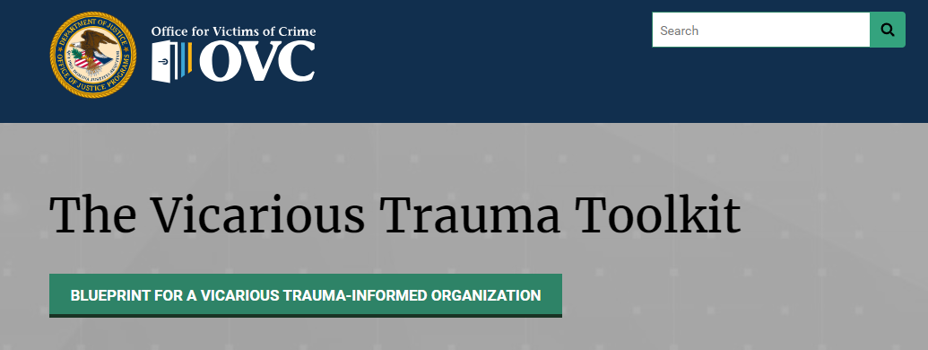
Framework: OVC’s VTT
FIVE ORGANIZATIONAL STRATEGIES
Leadership and Mission
Management and Supervision
Employee Empowerment and Work Environment
Training and Professional Development
Staff Health and Wellness
https://ovc.ojp.gov/program/vtt/what-is-the-vt-org#five-org

Slide 8
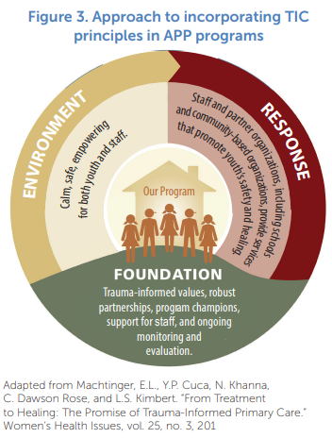
Framework: Promising Youth Programs
From Incorporating Trauma-informed Care In Adolescent Pregnancy Prevention Programs
Incorporating Trauma-Informed Care in Adolescent Pregnancy Prevention Programs: Significance and Resources for Grantees | The Administration for Children and Families (hhs.gov)

Slide 9
Framework: The Missouri Model
Trauma Aware
Trauma Sensitive
Trauma Responsive
Trauma Informed
https://dmh.mo.gov/media/pdf/missouri-model-developmental-framework-trauma-informed-approaches

Slide 10
Strategies for Trauma Informed Leadership

Slide 11
Strategies: OVC’s VTT
FIVE ORGANIZATIONAL STRATEGIES
Leadership and Mission
Management and Supervision
Employee Empowerment and Work Environment
Training and Professional Development
Staff Health and Wellness
https://ovc.ojp.gov/program/vtt/what-is-the-vt-org#five-org

Slide 12
Strategies: OVC’s VTT
Leadership and Mission
Proactively integrate trauma informed strategies into workplace structures
Maintain a clear vision that supports a trauma informed mission
Regularly model and promote open and respectful communication
Management and Supervision
Foster supportive relationships based on inclusivity, mutual respect, and trust
Promote policies and practices that lessen the negative impact of the work
Seek out and support staff following critical or acute incidents
Conduct performance evaluations that include discussions of vicarious trauma.
https://ovc.ojp.gov/program/vtt/what-is-the-vt-org#five-org

Slide 13
Strategies: OVC’s VTT
3. Employee Empowerment and Work Environment
Foster teamwork
Encourage collaboration within and outside of the program
Create formal and informal opportunities to connect
Diversify job tasks whenever possible
4. Training and Professional Development
Promote continuing education, professional development, and networking opportunities
Provide thorough orientation and ongoing training
Enable access to resources
Support staff participation in on- and offsite learning opportunities
https://ovc.ojp.gov/program/vtt/what-is-the-vt-org#five-org

Slide 14
Strategies: OVC’s VTT
5. Staff Health and Wellness
Recognize links between health/wellness and staff satisfaction and productivity
Devote time and resources to promoting staff well-being
Encourage and provide health and wellness activities
Incorporate wellness into policies and practices.
https://ovc.ojp.gov/program/vtt/what-is-the-vt-org#five-org

Slide 15
Strategies: Promising Youth Programs
SIX STEPS TO CREATING THE FOUNDATION
Identify a champion
Assess current approaches
Develop policies
Form partnerships
Train staff
Assess outputs and outcomes
Incorporating Trauma-Informed Care in Adolescent Pregnancy Prevention Programs: Significance and Resources for Grantees | The Administration for Children and Families (hhs.gov)

Slide 16
Strategies: Promising Youth Programs
Identify a champion
The purpose of the champion is to ensure trauma informed approaches remain a priority.
They can also work to gain buy in from the program and partners.
This could be a supervisor or other person in senior management.
Assess current approaches
Use the organizational assessment tool to take stock of where you stand.
Use this information to develop priority areas and next steps.
Develop policies
Write policies that acknowledge the prevalence of trauma among youth and staff.
Write policies regarding how staff should handle disclosures.
Incorporating Trauma-Informed Care in Adolescent Pregnancy Prevention Programs: Significance and Resources for Grantees | The Administration for Children and Families (hhs.gov)

Slide 17
Strategies: Promising Youth Programs
4. Form partnerships
Establish partnerships with entities that can provide additional services to youth and staff who may have experienced various forms of trauma.
5. Train staff
Train all program staff on trauma informed approaches, not just staff who work directly with youth.
Train all program staff on how to support colleagues and available resources for vicarious trauma.
6. Assess outputs and outcomes
Continually assess whether trauma informed policies and procedures require updating.
Consider approaches to evaluate trauma informed implementation.
Incorporating Trauma-Informed Care in Adolescent Pregnancy Prevention Programs: Significance and Resources for Grantees | The Administration for Children and Families (hhs.gov)

Slide 18
Strategies: The Missouri Model
Trauma Aware
Trauma Sensitive
Trauma Responsive
Trauma Informed
Provide an introductory training with all staff.
Develop a core team who can be responsible for leading trauma informed efforts.
Examine key practices and start to implement changes.
Assess outputs and outcomes.
Continually make improvements as identified.
https://dmh.mo.gov/media/pdf/missouri-model-developmental-framework-trauma-informed-approaches

Slide 19
Strategies: The Missouri Model
SIX EXAMPLES OF APPROACHES USED IN MISSOURI
Universal Trauma Training
Community Building Practices
Prioritizing Staff Needs
Changing Discipline
Creating Space to Regulate
Connecting Community
https://dmh.mo.gov/media/pdf/missouri-model-developmental-framework-trauma-informed-approaches

Slide 20
Strategies: The Missouri Model
Universal Trauma Training
Conduct baseline training with all staff, including educators, support staff, transportation, administrators, the board, etc.
Community Building Practices
Build community between youth and staff and amongst staff.
Consider informal networking, community circles, and culture building
Prioritizing Staff Needs
Implement changes to support staff well-being, such as a space for staff to unwind, providing education about available resources, ensuring staff have time to step away and meet their needs.
https://dmh.mo.gov/media/pdf/missouri-model-developmental-framework-trauma-informed-approaches

Slide 21
Strategies: The Missouri Model
4. Changing Discipline
Consider alternative approaches to student discipline, such as restorative practices, avoiding suspensions, and encouraging reflection.
5. Creating Space to Regulate
Create sensory, calming, or cool-down spaces for students and staff to use to support self-regulation.
Encourage students and staff to use these spaces at times that work for them.
6. Connecting Community
Provide education about trauma and self care to students, their parents, and the community at large.
Find ways to engage parents on this topic
https://dmh.mo.gov/media/pdf/missouri-model-developmental-framework-trauma-informed-approaches

Slide 22
Organizational Assessment
Where does your program stand?

Slide 23
Organizational Assessment
Review the two organizational assessment tools provided.
Select one tool to complete or consider.
Which do you prefer? Why?

Slide 24
Where does your program stand?
What have your programs accomplished?
Where is there room for growth?
What feels like a feasible next step?

Slide 25
What can you do today?

Slide 26
What can you do today?
If you believe you have a coworker who is experiencing the negative impacts of vicarious trauma, consider the following:
Reach out to talk. It might be helpful to just listen. If they’re interested, normalize the experience of vicarious trauma and share what has worked for you.
Encourage them to find ways to create space between their professional and personal life, such as a transition routine to get out of the work mindset.
Ensure their attending to basic self care, like hydrating, sleeping, and eating regularly.
Encourage them to have discussions with their supervisor.
https://ovc.ojp.gov/program/vtt/what-is-vicarious-trauma#vtt-model

Slide 27
What else can you do today?
What can you communicate to your leaders? What can you take on?

Slide 28
Reflection
What is one thing from this session that stood out to you?
What is one question that you still have?
What is one thing you want to take back to your team?

