Slide 1
Rewarding Relationships
DIGITAL CITIZENSHIP
Adapted version for youth with intellectual and developmental disabilities

Slide 2
PRE-TEACH
Boundaries are limits and rules you can set for yourself to keep you safe and healthy.
Give an example of a boundary someone might make in a relationship.

Slide 3
Learning Objectives
l
Reflect on how your relationships are affected by devices and the internet.
Identify the qualities of healthy and rewarding relationships.
Use the Feelings & Options thinking process to brainstorm strategies for navigating challenging relationships.
2
3

Slide 4
CONSIDER: TEXTING AND RELATIONSHIPS
How often do you chat or text with your friends?
How long do you wait to text back?
What if your friend doesn’t text you back right away?

Slide 5
WATCH + DISCUSS
Discuss:
How do people say smartphones and social media affect their friendships?
Is it more positive or negative?
To watch this video on the Common Sense Education site, click here.

Slide 6
WATCH + DISCUSS
Discuss:
How can you tell if a relationship is healthy?
How would someone treat their friend or partner in a healthy relationship?
How would you want to be treated by a friend or romantic partner?
To watch this video on YouTube, click here.

Slide 7
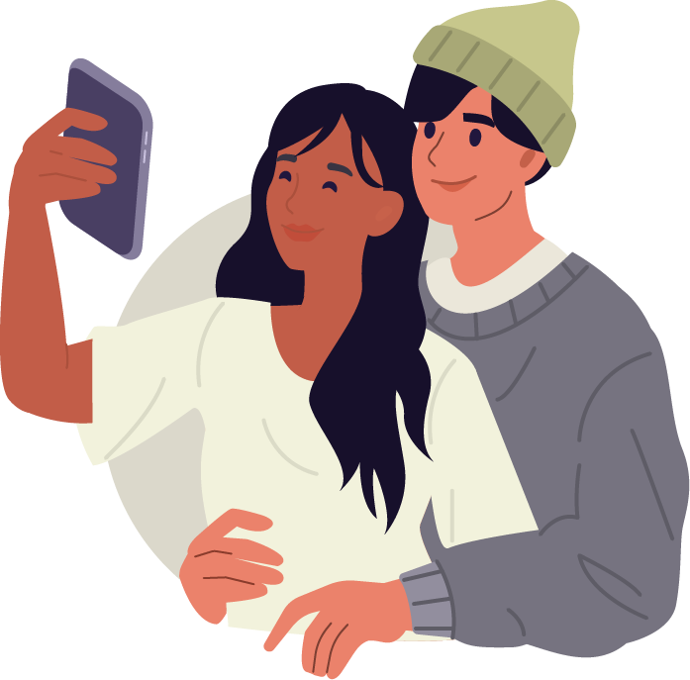
ACTIVITY: FRIENDSHIPS AND FEELINGS
Keys to a healthy relationship
Each person supports and encourages the other
Each person is interested in what the other person has to say
Disagreements are respectful
Both people give and take in the relationship
There is no verbal or physical abuse
There is no pressuring someone to do things they don’t want to do
The relationship makes both people

Slide 8
ACTIVITY: FRIENDSHIPS AND FEELINGS
Signs of an unhealthy relationship
One or both people do not support each other.
One or both people do not respect each other.
There is verbal or physical abuse.
One person tries to keep you away from your friends or family.
One person thinks they should always get their way or tries to control the other person.
One or both people are pressured to do things they don’t want to do.
The relationship makes one or both people feel bad about themselves.

Slide 9
Red flag feeling
KEY VOCABULARY
When something happens that makes you feel uncomfortable, worried, or upset.

Slide 10
ANALYZE: RED FLAG FEELINGS
Feelings & Options
Identify. Who are the people involved in the situation? What challenge are they facing?
Feel. What is each person in the situation feeling? Why is the situation making them feel this way?
Imagine. Imagine options for how the situation could be handled. What could the people do?
Say. What could the people involved say?

Slide 11
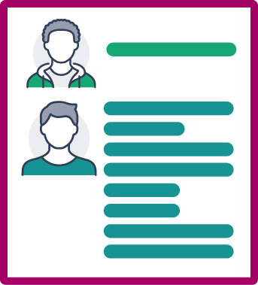
ANALYZE: RED FLAG FEELINGS
Jason and Tim Scenario
Jason's classmate Tim had started texting Jason a lot, every day.
At first Jason was happy to be talking to Tim out of school.
Tim's parents were fighting a lot, and Tim's life at home had gotten really stressful.
The texting had become overwhelming for Jason.
Jason cared about Tim and didn't want to make his situation any worse by not being a good friend.
Jason thought he needed to set some boundaries, but he wasn't sure how and didn't want to make things harder for Tim.

Slide 12
ACTIVITY: FEELINGS & OPTIONS
IDENTIFY
Who are the people involved in the situation?
What challenge are they facing?

Slide 13
ACTIVITY: FEELINGS & OPTIONS
FEEL
What is each person in the situation feeling?
Why is the situation making them feel this way?

Slide 14
ACTIVITY: FEELINGS & OPTIONS
IMAGINE
Imagine options for how the situation could be handled.

Slide 15
ACTIVITY: FEELINGS & OPTIONS
SAY
Thinking more about the idea you chose for handling the situation, what could the people involved say?

Slide 16
Lesson Review

Slide 17
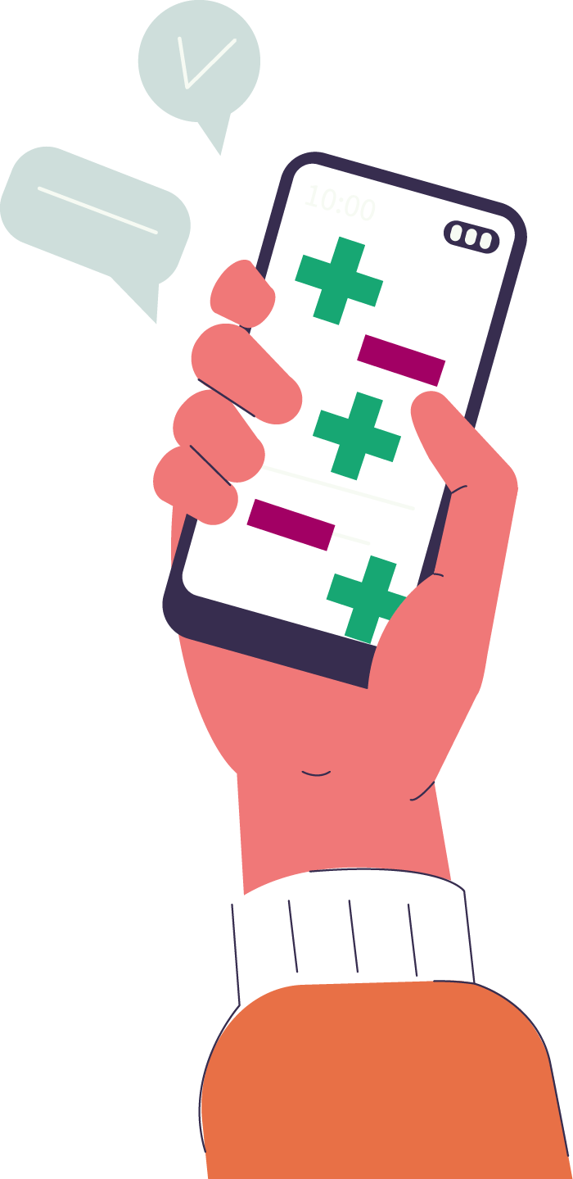
GROUP REVIEW
Technology: positive or negative?
Friends can talk or chat more easily, even when they are far away.
Friends can ignore limits and expect other people to be available all times of the day or night.
Friends can want to talk to chat with you even when you want time alone.
You can connect with friends who have similar interests.

Slide 18
GROUP REVIEW
Feelings: good or bad?
A friend shares a funny video.
Someone asks you to share a private inappropriate video.
Someone responds to your text right away and makes you feel like they listened to you.
Someone you don’t know that well messages you and asks for private information.
Someone likes your post.

Slide 19
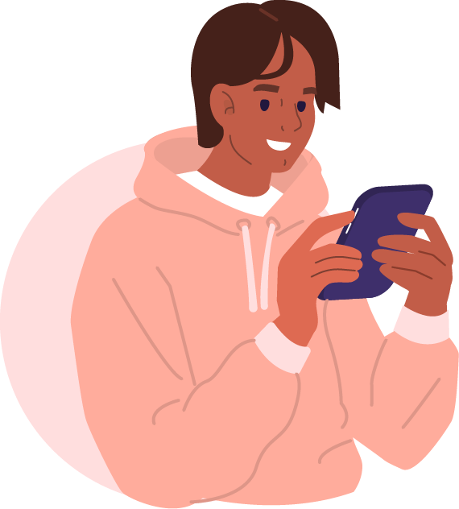
GROUP REVIEW
Alan and George are good friends.
They talk during the day at school and usually text each other when they get home.
Alan has gotten really into anime and has started texting George all the time about the shows he is watching.
George is not really into anime, but Alan is pushing him to watch what he's watching.

Slide 20
GROUP REVIEW
IDENTIFY
Who are the people involved in the situation?
What challenge are they facing?

Slide 21
GROUP REVIEW
FEEL
What is each person in the situation feeling?
Why is the situation making them feel this way?

Slide 22
GROUP REVIEW
IMAGINE
Imagine options for how the situation could be handled.

Slide 23
GROUP REVIEW
SAY
Thinking more about the idea you chose for handling the situation, what could the people involved say?

Slide 24
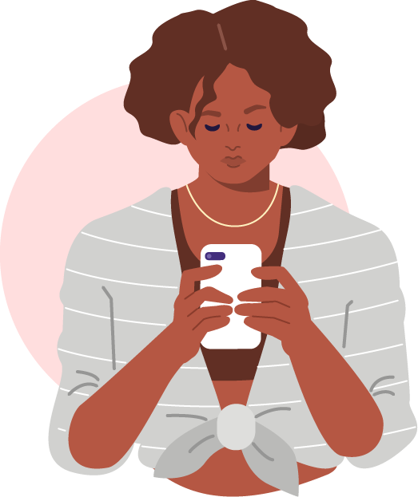
GROUP REVIEW
Anthony and Demi got into an argument because Demi wasn't responding to Anthony's texts.
Demi was feeling overwhelmed by how often Anthony was texting her.
They decided to meet in person to talk about how to be good friends to one another.

Slide 25
GROUP REVIEW
IDENTIFY
Who are the people involved in the situation?
What challenge are they facing?

Slide 26
GROUP REVIEW
FEEL
What is each person in the situation feeling?
Why is the situation making them feel this way?

Slide 27
GROUP REVIEW
IMAGINE
Imagine options for how the situation could be handled.

Slide 28
GROUP REVIEW
SAY
Thinking more about the idea you chose for handling the situation, what could the people involved say to make them both feel good?

Slide 29
GROUP REVIEW
Which statement would make them both feel good?
"I don't know how other people put up with the number of messages you send!"
"I've been feeling overwhelmed by all the texting lately. I want you to know that when I don't answer, it's not because I'm ignoring you. I just don't like being on my phone all the time."
"Why have you been texting so much? You are so annoying."
"It's been hard to keep up with all the texts lately, so can we just not text each other anymore?"

Slide 30
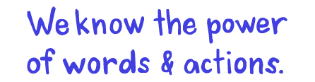
We know the power of words & actions.

